Slide 1

AI Coder: Vibe Coder to Agentic Engineer
The Missing Manual
Week 3
Day 1

Slide 2
3 Weeks to Expert Agentic Coder
Core skills
Products / Features
Projects
Week 3: Agentic Engineering as an expert
Multi-Agents
Sub-Agents
Hooks
Sandboxing
Large Codebase
Workflow
Swarms
Orchestrators
Project 4: Capstone
Week 2: Vibe Engineering as a professional
Claude Code
OpenCode
others
Commands
Checkpoints
Ralph Loops
MCP
Skills
Plugins
Workflows
Team
Debugging
Project 3: SaaS Platform
Week 1: Vibe Coding for fun and profit
Agentic Coding Landscape
Foundations
AGENTS.md
Context
Cursor
Copilot, Codex
Antigravity
Project 1: YOLO
Project 2: Commercial MVP

Slide 3
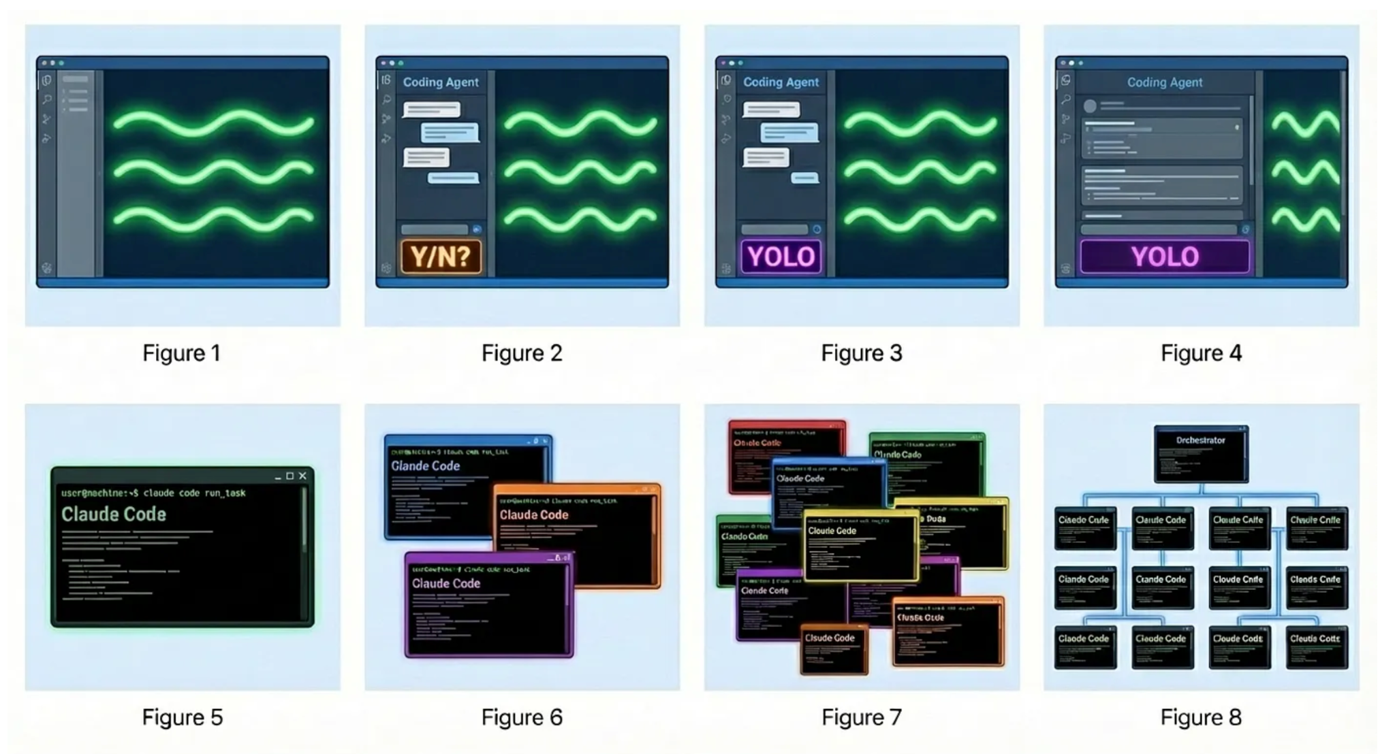
“Evolution of the Programmer in 2024–2026” by Steve Yegge
Stage 1
Stage 2
Stage 3
Stage 4
ChatGPT
AI auto-complete
Coding agent in IDE sidebar, asks permission before changes
Coding agent in IDE sidebar, YOLO mode
Coding agent in IDE main window, YOLO mode, check diffs
Stage 5
Stage 6
Stage 7
Stage 8
Coding agent in CLI, YOLO, diffs scroll by
Multi-agent in CLI, 3-5 agents
10+ agents in CLI manually managed
Agents orchestrate agents

Slide 4
Which approach is right
Mission critical software, large codebase, highly innovative code
Micro- manage, Approve, Frequent resets
Plan, Execute, Review, Test
SDD;
Trust but verify
MVPs, new build, risk appetite, boilerplate code
YOLO
Ralph Loops
Multi- agent
swarms,
orchestrate
Your job is to deliver code that is proven to work

Slide 5
Pro techniques fall into 2 camps
CHAOS
YOLO
Ralph Loops
GSD
Swarms
CONTROL
Use of files
Self-correcting
Sandboxes
Orchestration
The goal is controlled chaos
Driven by project maturity and your comfort
Start by prioritizing control

Slide 6





Claude Code Pro Features
Create a Slash Command
Multi-Agents and Sub-Agents
Agent teams
Hooks
Create a Plugin

Slide 7
Pros & Cons of Sub-Agents
Parallelism - accelerate by working on different components at the same time
Self-correction - keep the project on rails by having agents that check and test
Context efficiency - keep context unpolluted with information related to other tasks
Task focus - keep bounded responsibility and prompts to each Agent, reducing context switching
Orchestration complexity - more moving parts
Boundary issues - mistakes in the dependencies between agents
Error amplification - mistakes can compound leading to unreliable outcomes.. or chaos!
Costs - tokens can add up

Slide 8
3 Weeks to Expert Agentic Coder
Core skills
Products / Features
Projects
Week 3: Agentic Engineering as an expert
Multi-Agents
Sub-Agents
Hooks
Sandboxing
Large Codebase
Workflow
Swarms
Orchestrators
Project 4: Capstone
Week 2: Vibe Engineering as a professional
Claude Code
OpenCode
others
Commands
Checkpoints
Ralph Loops
MCP
Skills
Plugins
Workflows
Team
Debugging
Project 3: SaaS Platform
Week 1: Vibe Coding for fun and profit
Agentic Coding Landscape
Foundations
AGENTS.md
Context
Cursor
Copilot, Codex
Antigravity
Project 1: YOLO
Project 2: Commercial MVP

Slide 9

AI Coder: Vibe Coder to Agentic Engineer
The Missing Manual
73%
Complete

